Slide 1
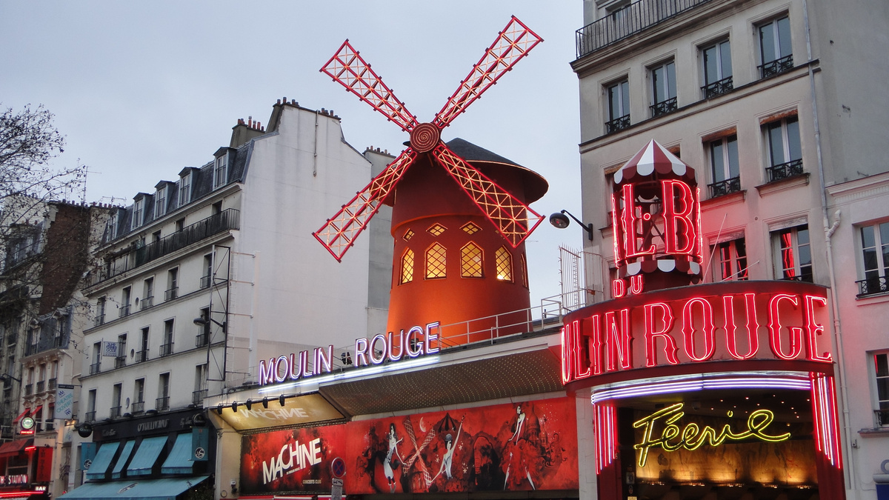




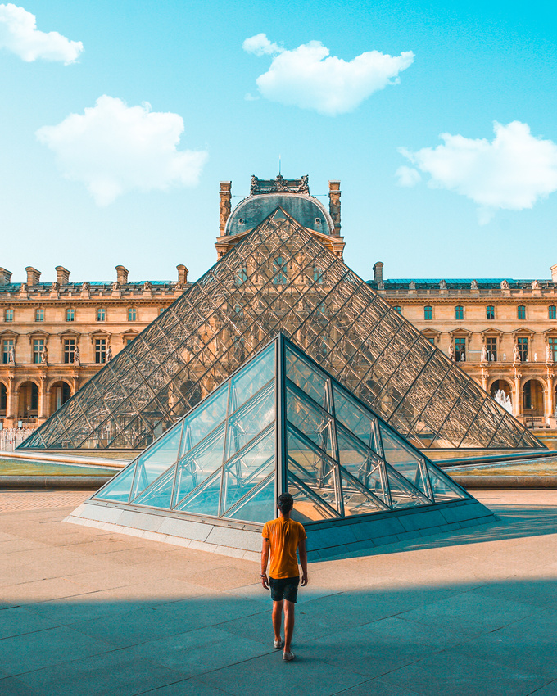
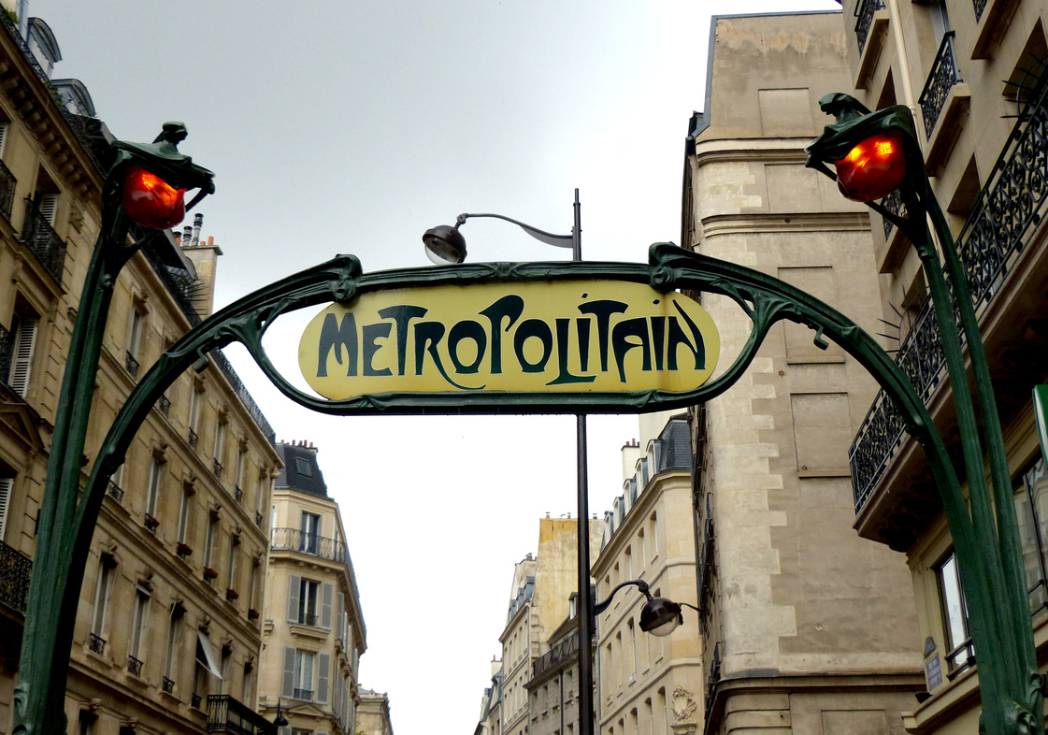


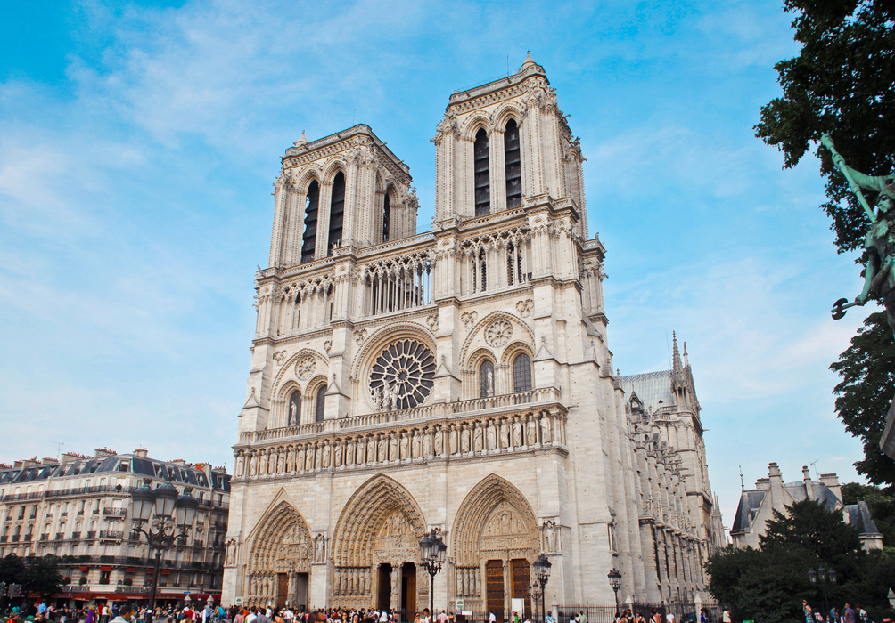

Emma Eberle
Sharon Chemmama
AroundMe
Alexis Christien
Lina Benzemma

Slide 2





Emily, a tourist exploring Paris, moves from store to store, her arms full of shopping bags. After a few hours of shopping..
I need to park my car in a nearby parking lot!!
I urgently need to go to the bathroom!!
Since discovering the mouthwatering pastries by Cédric Grolet, I’ve indulged a little too much! I need to find a nearby gym !
After exploring Paris through its shops, I realize that I’ve forgotten the most important thing: to discover the history of this magnificent city

Slide 3




What if Emily had a solution at her fingertips?
Avec AroundMe, Emily peut…
🅿️ Trouver les parkings les plus proches.
🚻 Découvrir les toilettes publiques dans les environs.
🏛️ Explorer l'histoire et les anecdotes de la rue où elle se trouve.
🏋️ Repérer des gyms à proximité.

Slide 4
What can I do with AroundMe ?
AroundMe allows you to get many information about Paris.
For example, if you tell yourself...
...Wow, this street is beautiful, I'd love to know more about its history.
...Hmmm where can I park and what are the prices of the parkings ?
...I'd like to go to the toilet but I'm too far from my hotel...
...Paris is obviously the city of culture, I have to visit museums, but where can I find them?
...I want to prepare my summer body but I don't know where to do sport in this city.
AroundMe is there for you, and will give you various information about the street, such as the origin of its name and the surrounding neighbourhoods.
Here again, AroundMe is there for you, providing you with the nearest parking to your location and the associated rates
Even in those situation, AroundMe will come to the rescue and show you the nearest public toilets and their opening times.
Just like you, AroundMe's creators are museum enthusiasts, and will provide you with the museums closest to your location.
You know the drill now, AroundMe indicates you sports facilities from gyms to swimming pools. Now you have no more excuses for your summer body.

Slide 5
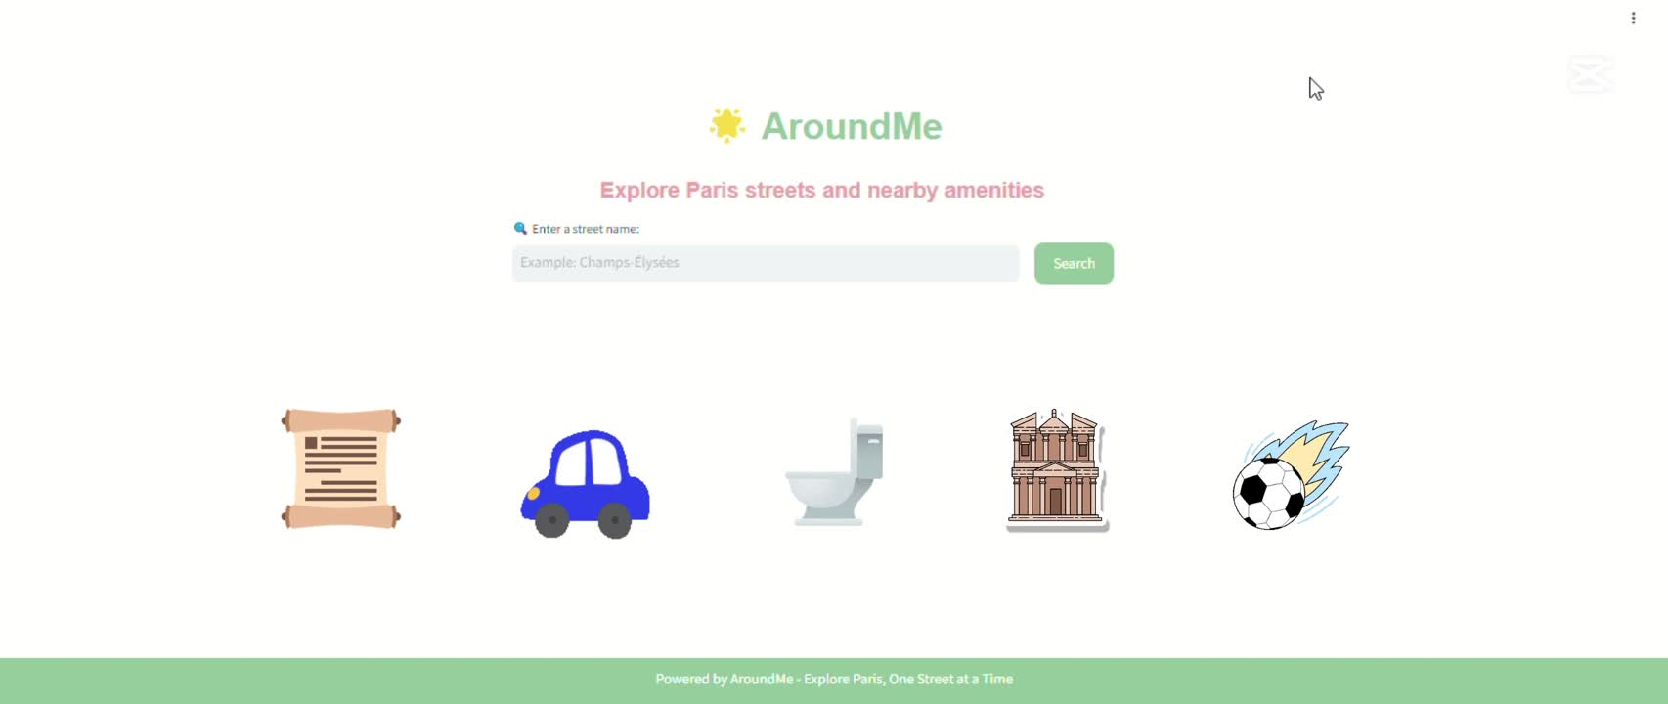
AroundMe: Discover the App in Action

Slide 6
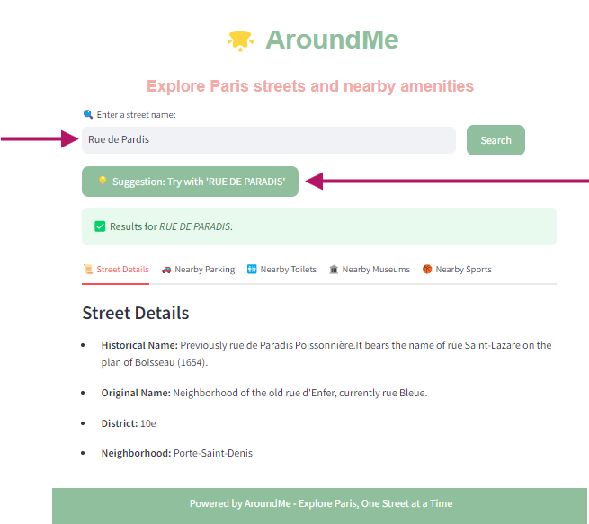
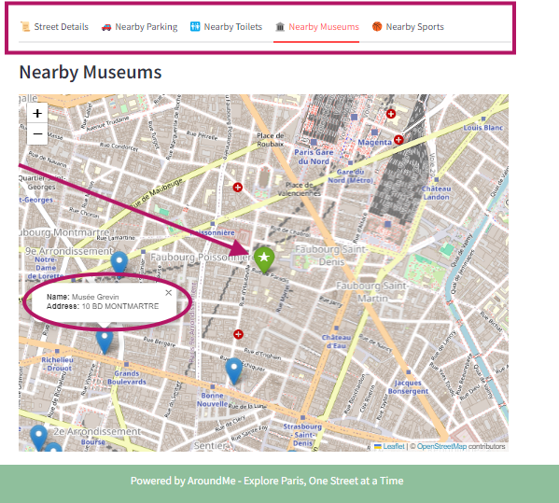
AroundMe: Discover the App in Action
Navigation Bar
Search
Bar
Suggestion
Your street
Information
Bubble

Slide 7

Our Retrospective Development Roadmap
Integration of "historical" street data as a simple application base.
Iterative process of adding sections to the application.
(Parking, sports...)
Project ideation.
Exploration of available public databases.
Setup of Docker and creation of a basic Streamlit interface.
Code cleanup and visual enhancement of the application.

Slide 8
Our Vision Roadmap
Improvement of Map Visuals: Upgrade map designs for better clarity, interactivity, and a more user-friendly experience.
Localization: Adapt the application for new regions or languages… and conquer the world! 🌍
Data Expansion: Integrate additional datasets to broaden the application's use cases.
Short-term goals
Mid-term goals
Long-term goals
Advanced Features Implementation: Add predictive analytics for parking availability or event scheduling.
AI-Powered Features: Introduce AI-based recommendations and real-time data updates.
Enhancement of Existing Features: Refine current sections (e.g., Parking, sports) for better usability and performance.

Slide 9

What’s around you? Find out with AroundMe!

